Slide 1


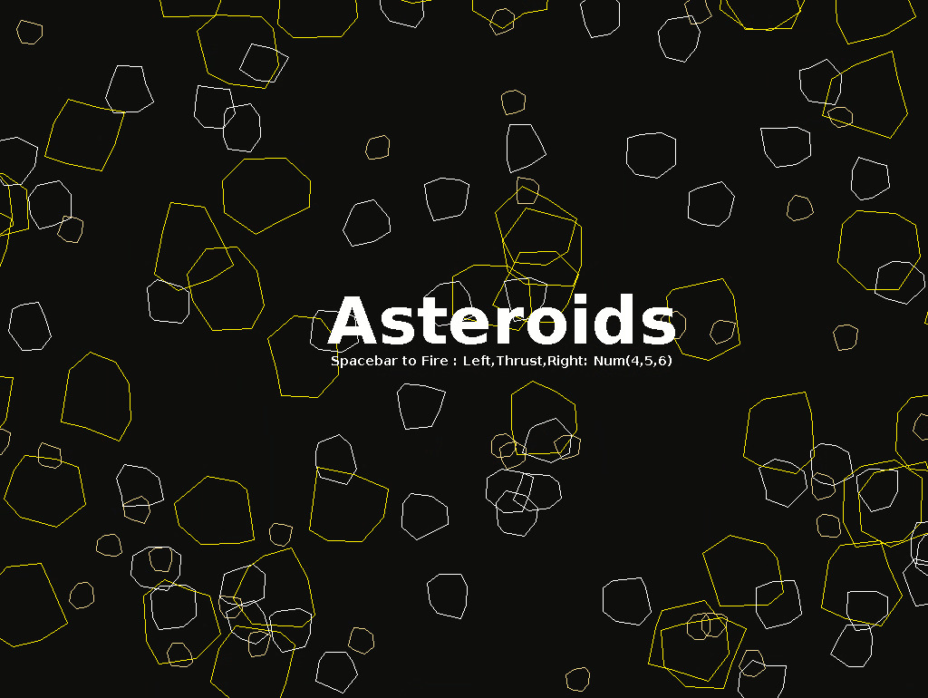
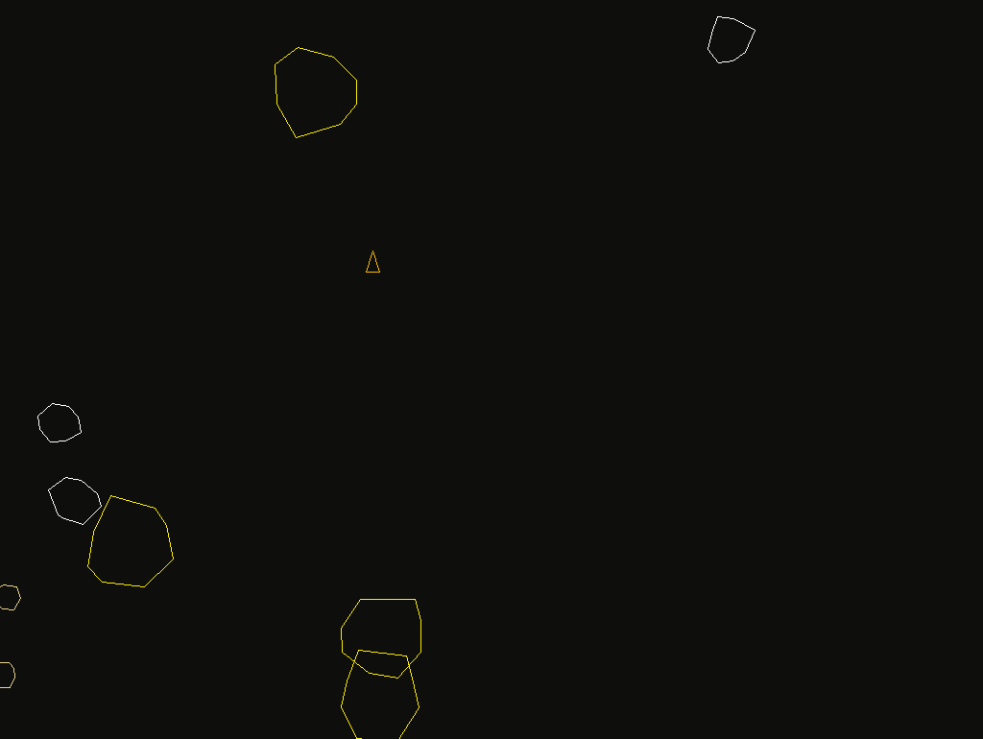
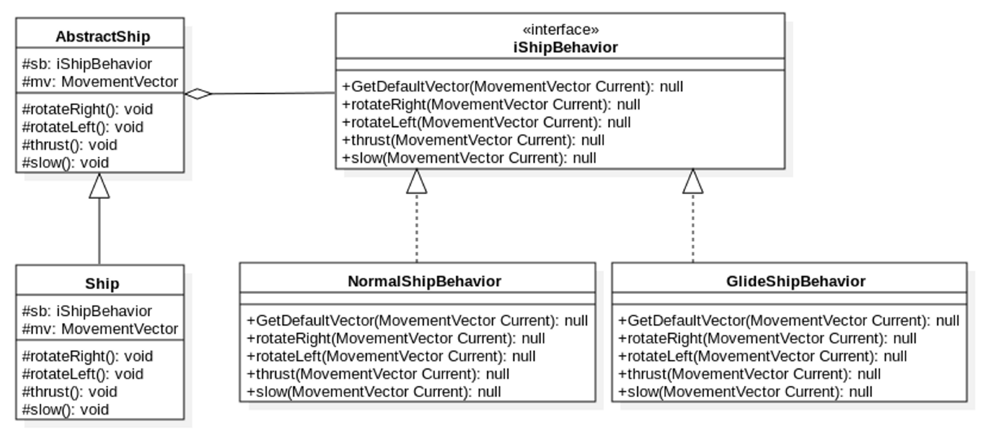
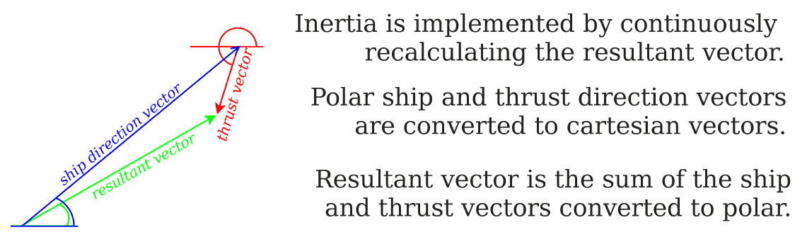
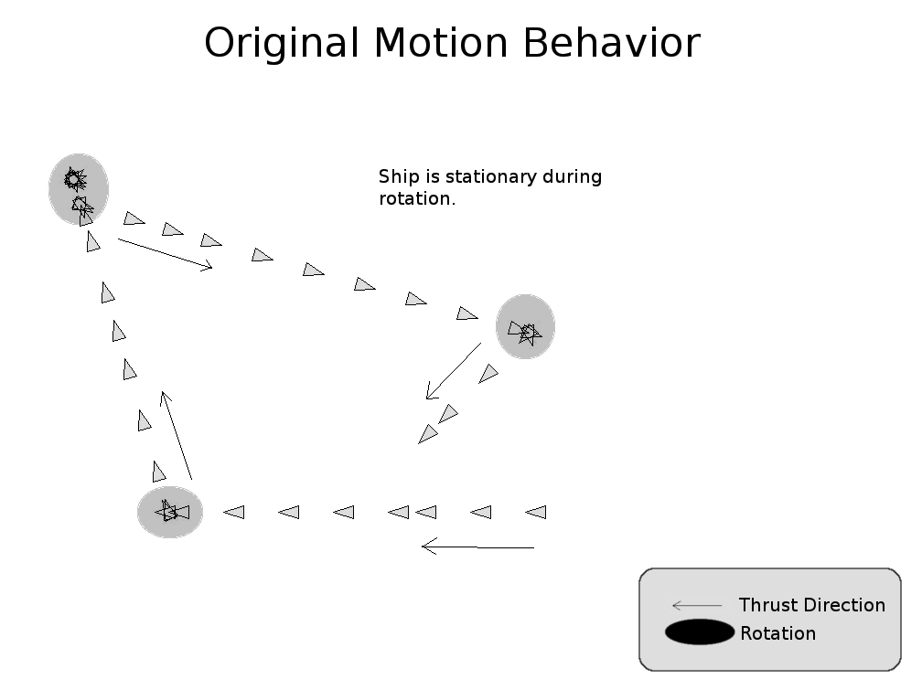
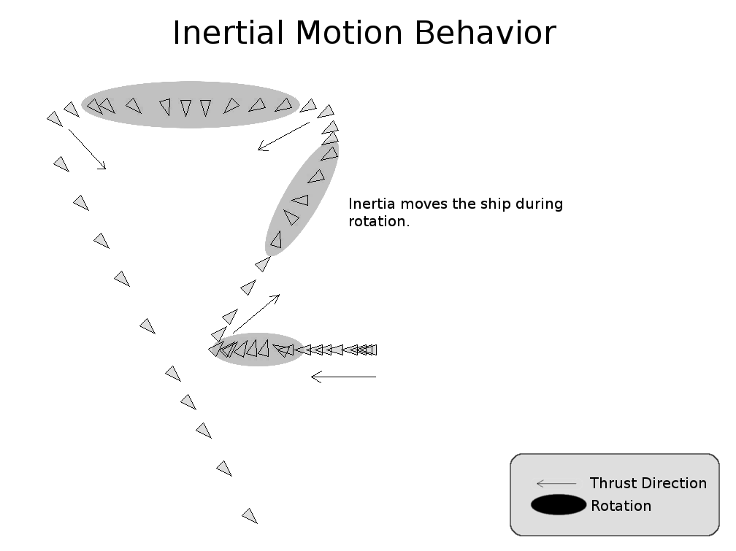
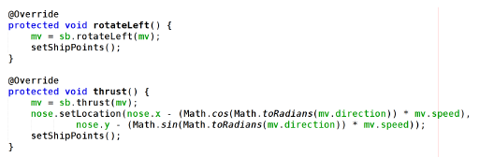
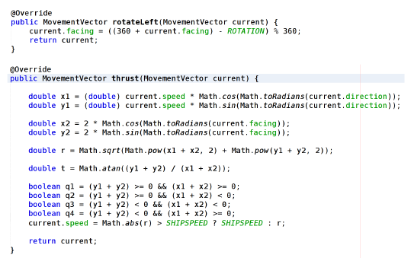
Asteroids: Leveraging Design Patterns to Implement Newton's Laws of Motion Gordon Klundt - Dr. Hong K. Sung (Faculty Advisor)
1
PROBLEM AND MOTIVATION
3
SOLUTION
4
DESIGN PATTERN
This version of Atari’s Asteroids was developed as a final term project to illustrate the usefulness and importance of design patterns. The bridge design pattern was used to implement the behaviors of many items in the game including the classic triangular “spaceship” associated with the classic game.
The original implementation of the spaceship behavior was rudimentary and unnatural. The application of the bridge pattern allowed for enhancement of the motion of the spaceship with minimal
Create the behavior interface.
Defines the operations for the behavior signatures.
Sets the initial vector.
Realize the different behaviors by applying the bridge.
The original behavior realization.
Easy to develop.
Fixed, arbitrary speed and direction.
Game play is simple and redundant.
The Newtonian behavior
Complex algorithm implementing inertia.
Speed and direction based on a force vector applied to the current force vector.
Game play is more challenging and creates a more realistic experience.
Use the Behavior in the Ship
References the behavior interface.
Store the current force vector of the ship for rendering.
Calculate the new force vector on each game loop using the appropriate behavior.
The design pattern used in this project:
Bridge pattern:
Intent is to decouple an abstraction from its implementation for independent variation.
Applied in order to avoid permanent binding of the abstract ship to the ship’s behaviors.
impact on the rest of the application. Newton’s Second Law of Motion was applied to the motion of the spaceship not only to add realism to the game, but also to enhance the challenge and enjoyment of the experience.
2
BACKGROUND
Design patterns used in game development provide a mechanism for separating concerns. The bridge pattern in particular allows for independent variation of an entity’s attributes and its behaviors. This is convenient and necessary in game development because the developer can separately concern themselves with the definition of what a thing is and what it does. This allows development of the interaction between things in an iterative and efficient way.
Additionally, a developer may easily create prototypes of different behaviors without affecting existing behaviors. The bridge pattern provides such an option for implementing varying behaviors, either by replacing the original behavior or by allowing additional behavioral choice. Implementing separate behaviors would be difficult and less readable using a tightly coupled design.
Rotation sets the “facing” component.
Thrust is accelerated at a constant rate of 2 pixels per tick up to the maximum ship speed.
Result MovementVector direction is calculated for the appropriate quadrant.
5
RESULT
The result of the implementation of the Newtonian behavior using the structural bridge pattern has the following benefits:
Natural and challenging game play.
Option of implementing additional behaviors.
Behavior is open for extension and closed for modification.

Slide 2
Q:
I just wanted to verify that the poster itself only has to cover one major technical aspect of my groups application. One thing my group is considering is the Wifi P2P section of the application. While this is very technical, not every person person worked on this particular aspect.
So, is it fine if the poster covers just one big technical aspect or should it contain a technical contribution from each member?
A:
The poster needs not include each member's contribution. In the limited space, include the most important things the TEAM has accomplished. Thus, some member's work may not be included at all. In other words, if the team regards WIFI P2P is a major achievement, it must be included in the poster.
However, in the Research Abstract, since there is no space limit, every achievement from every member can be included.

